Slide 1
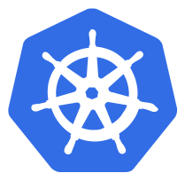
DNS
As of Kubernetes 1.10, DNS is a built-in service launched automatically using addon manger
The DNS Service can be used within pods to find other service running on the same cluster
Multiple containers within 1 pod don’t need this service, as they can contact each other directly
A container in the same pod can connect / communicate to other containers directly using localhost:port

Slide 2
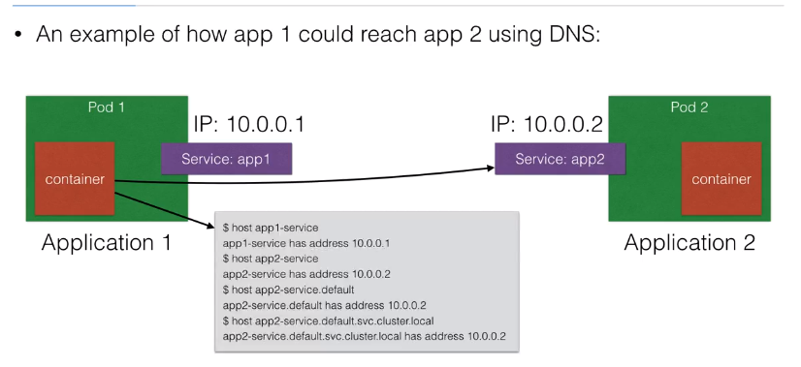
DNS

Slide 3
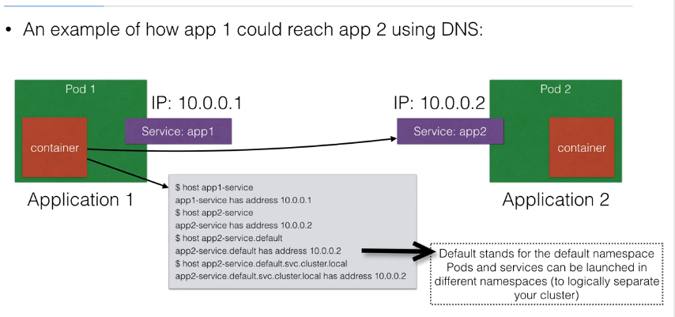
DNS

Slide 4
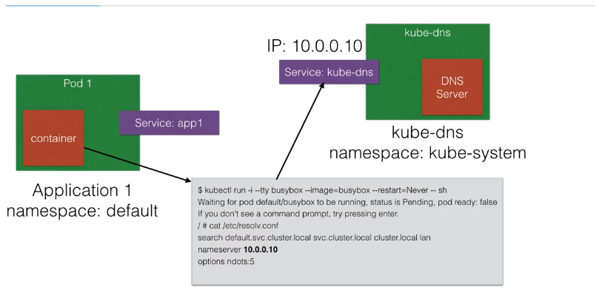
DNS – How does it work ?

Slide 5
Demo Placeholder
Service Discovery

Slide 6
ConfigMap
Configuration parameters that are not secret, cab be put in a Config Map
The input is again key-value pairs
The ConfigMap key-value pairs can then be read by the app using:
Environment Variables
Container command line arguments in the Pod Configuration
Using Volumes

Slide 7
Ingress
Ingress is a solution available since kubernetes 1.1 that allows inbound connection to the cluster
It’s an alternative to the external LoadBalancer & NodePorts
Ingress allows you to easily expose services that need to be accessible from outside to the cluster
With ingress you can run your own ingress controller ( basically a LoadBalancer ) within the kubernetes cluster
There are a default ingress controllers available, or you can write your own ingress controller

Slide 8
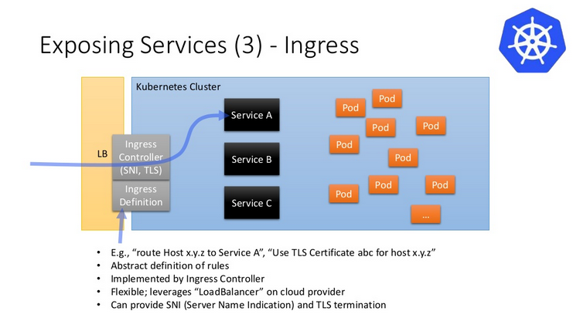
Ingress

Slide 9
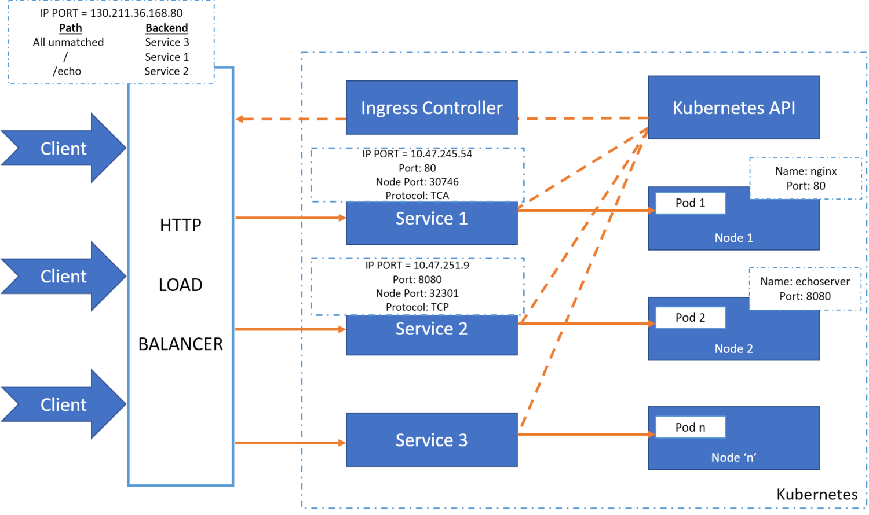
Ingress

Slide 10
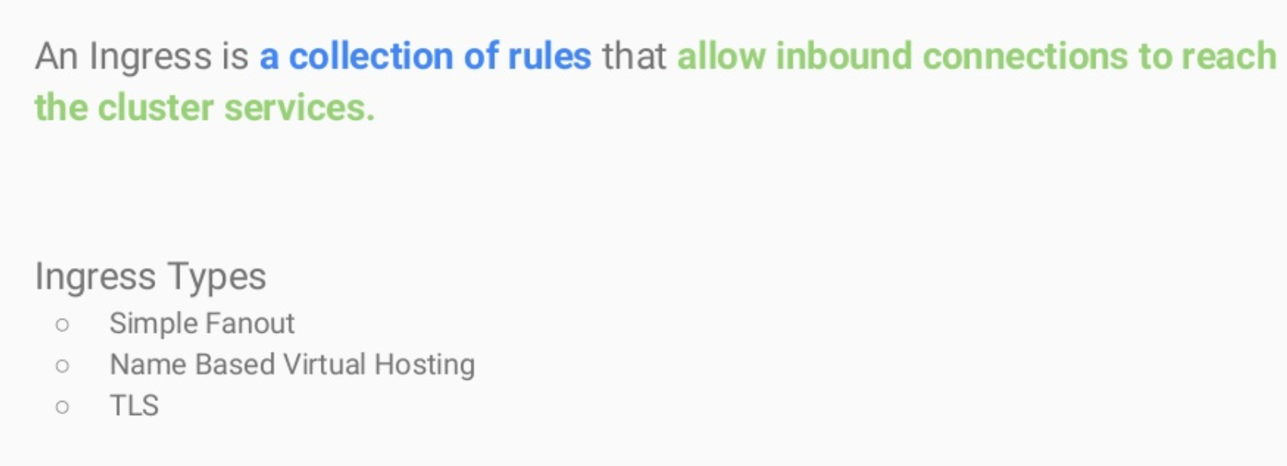
Ingress

Slide 11
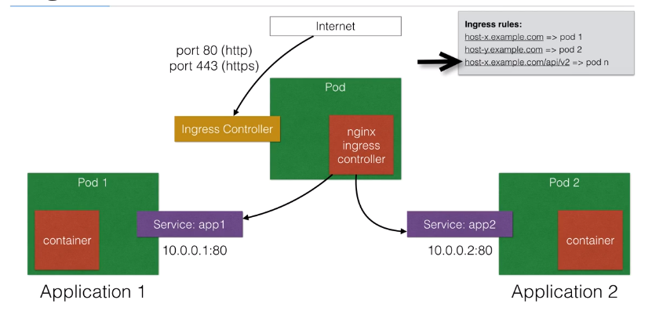
Ingress

Slide 12
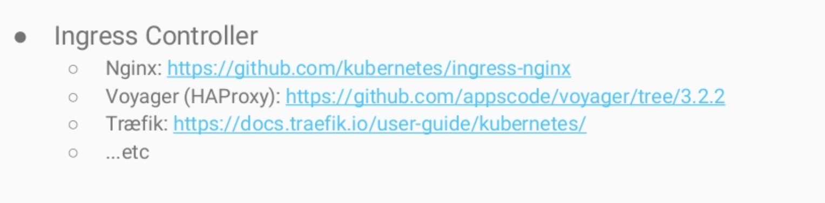
Ingress

Slide 13
Demo Placeholder
Ingress Controller

Slide 14


